Slide 1

Yosys Data Model Introduction
2022.11.22

Slide 2
Verific Tool Introduction
Yosys Tool Introduction
Yosys Data Model
Core Data Model

Slide 3
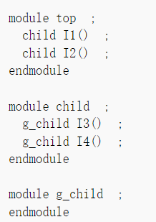
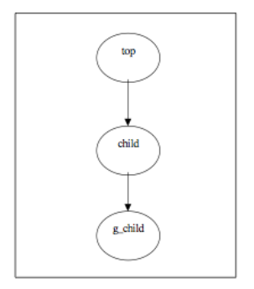
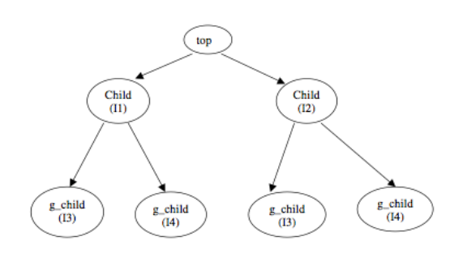
Verific Tool Introduction-Parse & Elaboration
Verific provides the parser platforms of System-Verilog, VHDL & UPF
“Lex&Yacc” is used to do System-Verilog & VHDL parse and generate an AST
Verific provides the two elaborators , one is called “static elaborator” and another is called “RTL elaborator” which is also called “synthesis”
static elaborator is used to do followings, top module extraction, instance hierarchical tree creation, the parameters of various modules propagation, Generate construct and array instance elaboration, hierarchical references resolved and so on
Parse
static elaborate

Slide 4
Verific Tool Introduction-Parse & Elaboration
Verilog element can be classified into synthesizable and unsynthesizable
The unsynthesizable includes: initial block, delay, UDP, event, fork…join, multi-edges, multi-drivers and so on;
The synthesizable includes: always, assign, begin…end, reg, wire, input, output, posedge, negedge, integer, function, case, tri, triand, trior, buffif0, buffif1, and, or, not, buf, xnor, nor, xor and so on
RTL elaboration is used to synthesize RTL to Netlist using Verific built-in logic synthesis library
The netlist including following objects at least: ports(portbus), nets(netbus), instances, operators, prims, fsms, parameters and reference.
Operators provide the complicated operations : OperAdder, OperLessThan, OperDiv, OperDualPortRam, OperMul, OperLut and so on;
Prims provide simple operations: CombPrim: PrimAnd, PrimOr, PrimPwr, PrimGnd, PrimX, PrimZ and so on; Non-CombPrim: PrimDff, PrimDLatch, PrimPmos, PrimPullup, PrimTristate and so on ; SVA Prim: PRIM_SVA_AT, PRIM_SVA_AND and so on.

Slide 5
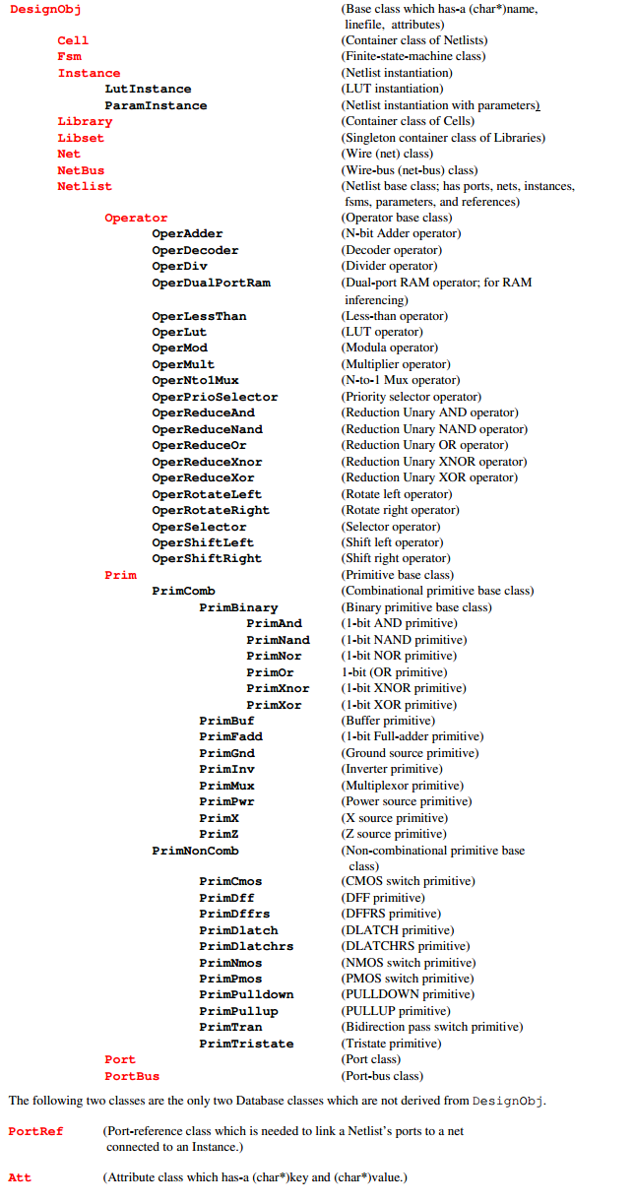
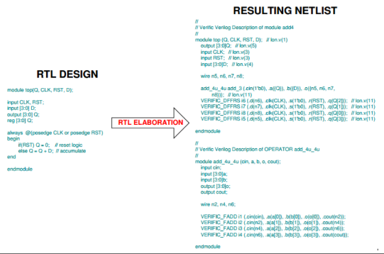
Verific Tool Introduction-Parse & Elaboration

Slide 6
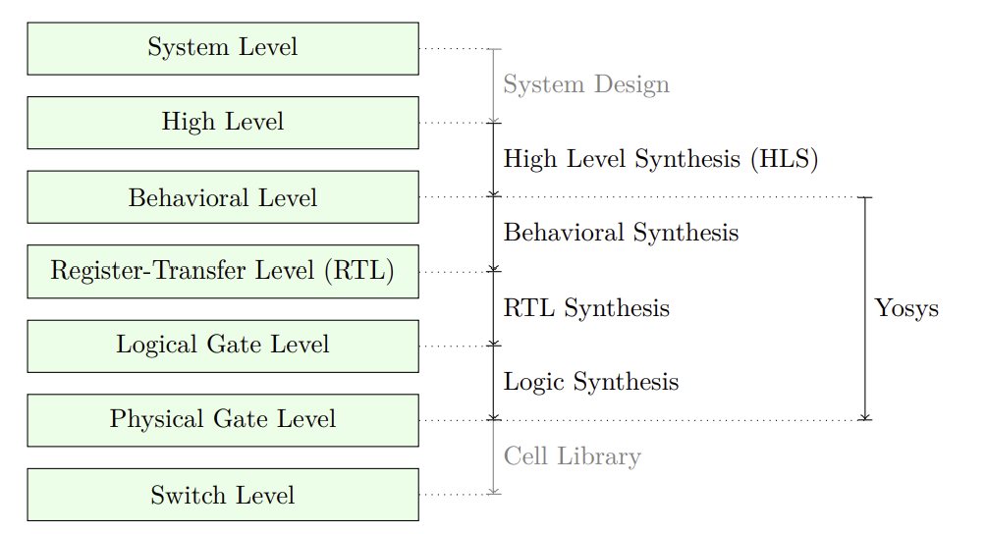
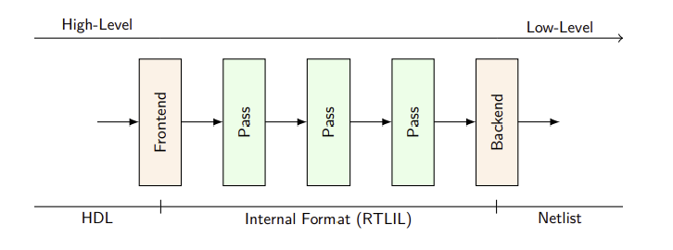
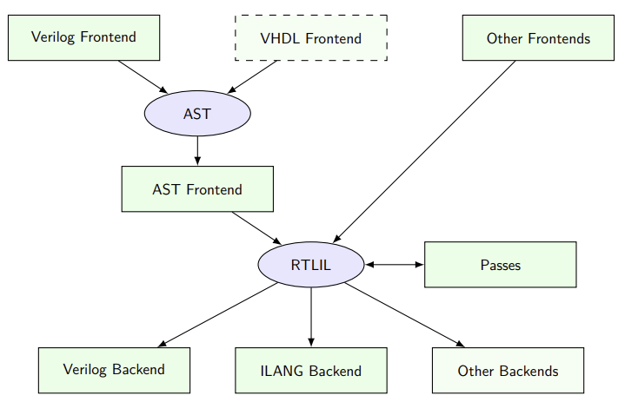
Yosys Tool Introduction
A tool that can be used as logic synthesis and formal verification
Read and process (most of ) modern Verilog-2005
Perform all kinds of operations of netlist (RTL, Logic, Gate)
Perform logic optimizations and gate mapping using ABC
A synthesis script controls Yosys
Frontends, the read input files (usually Verilog)
Passes, the perform transformations on the design in memory
Backends, that writes the design in memory to file (Verilog, BTOR, BLIF, EDIF…)

Slide 7
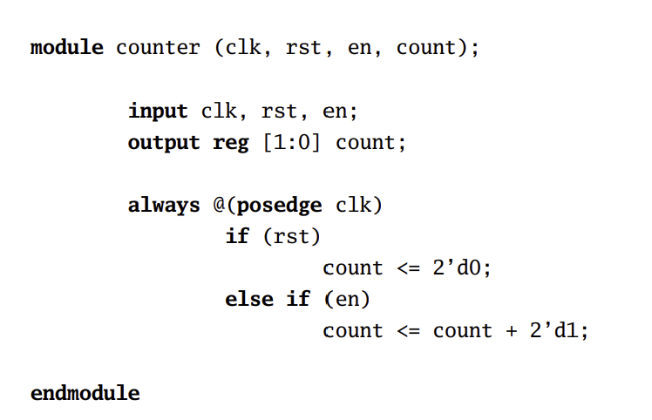
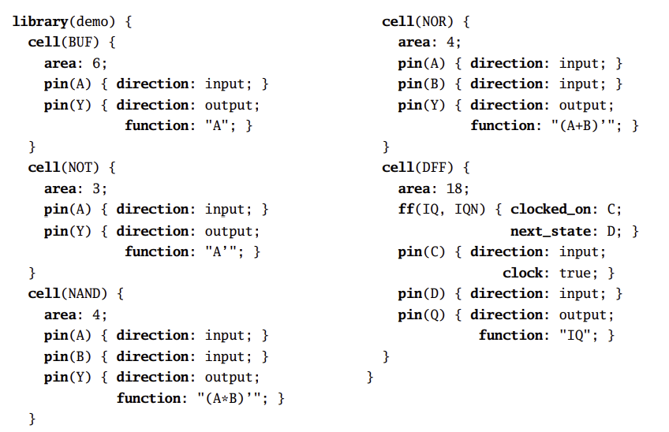
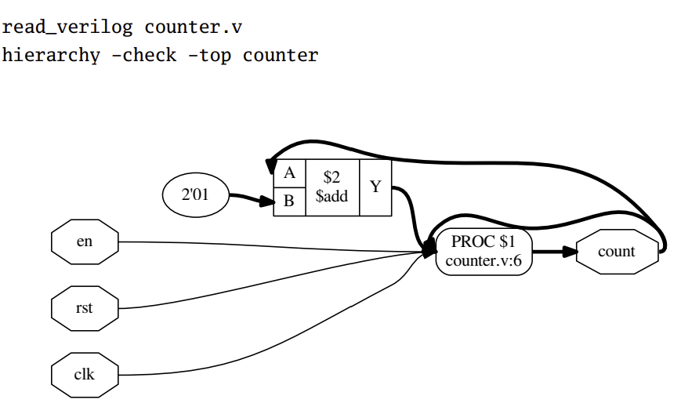
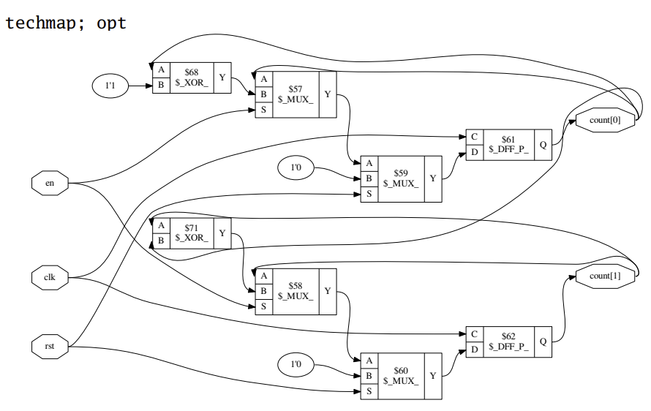
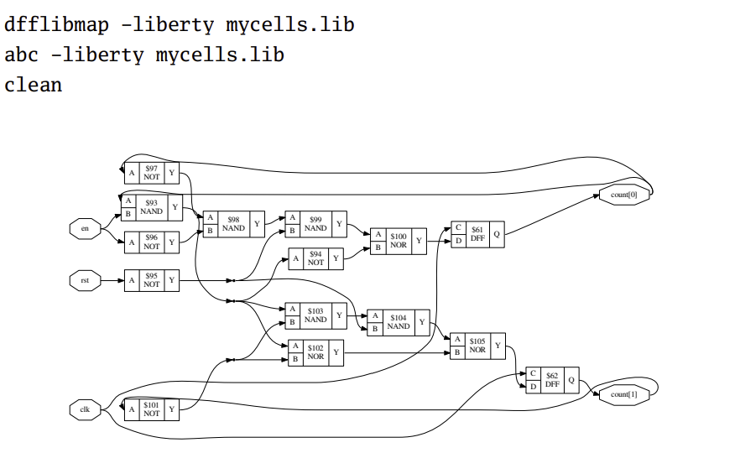
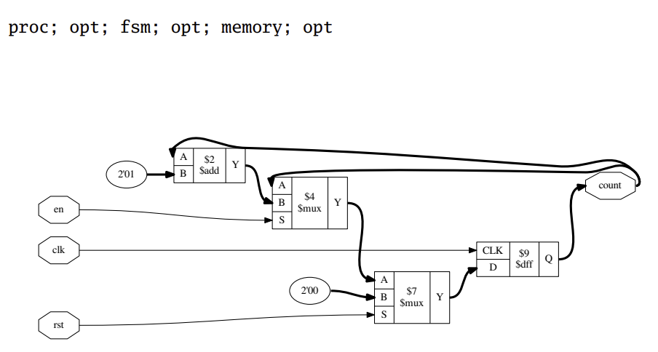
Yosys Tool Introduction

Slide 8
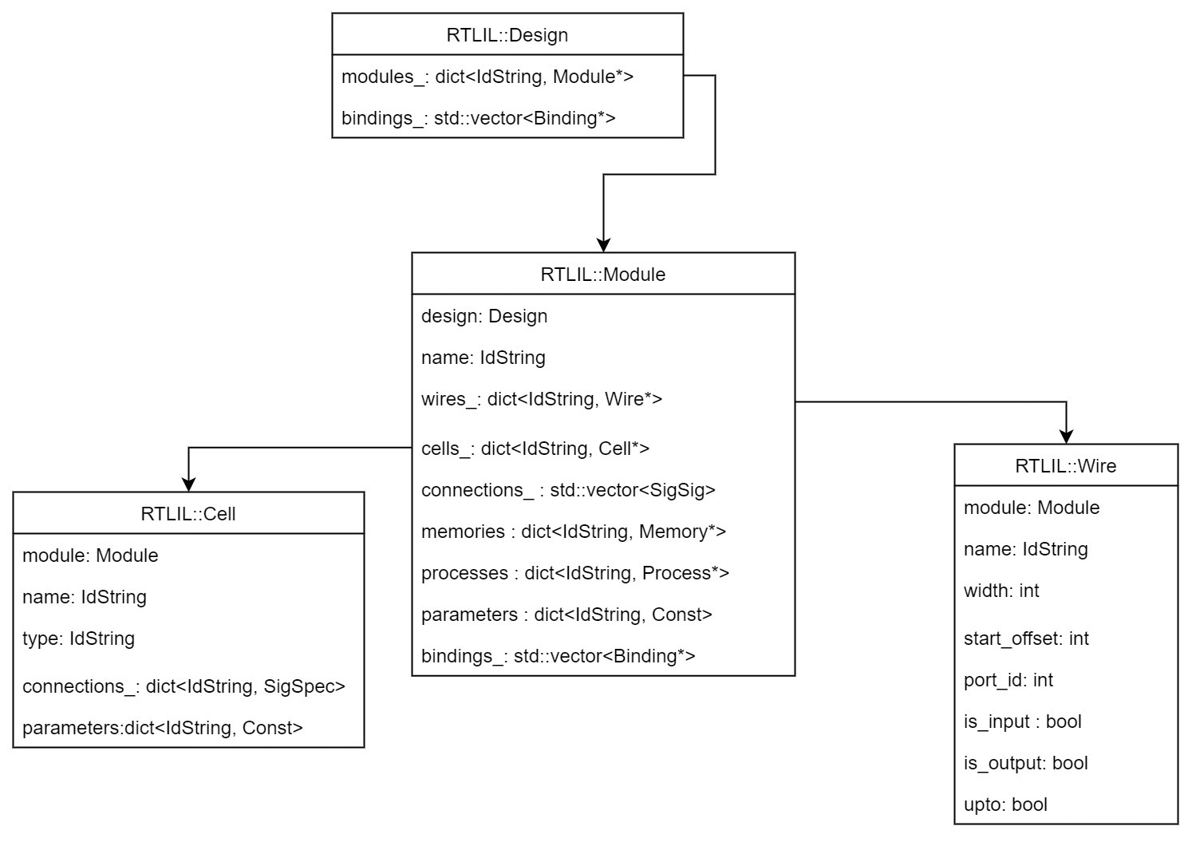
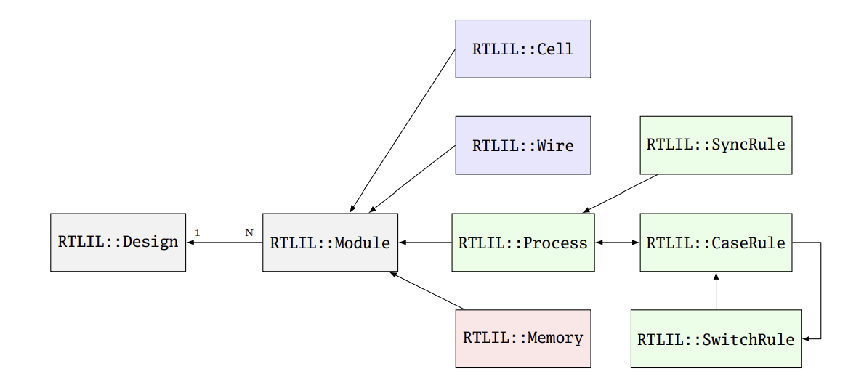
Yosys Data Model
struct RTLIL::IdString
struct RTLIL::Const
struct RTLIL::AttrObject
struct RTLIL::Selection
struct RTLIL::Monitor
struct RTLIL::Design
struct RTLIL::Module
struct RTLIL::Wire
struct RTLIL::Memory
struct RTLIL::Cell
struct RTLIL::SigChunk
struct RTLIL::SigBit
struct RTLIL::SigSpec
struct RTLIL::CaseRule
struct RTLIL::SwitchRule
struct RTLIL::MemWriteAction
struct RTLIL::SyncRule
struct RTLIL::Process
struct RTLIL::Binding

Slide 9
Yosys Data Model
module sub (clk, rst, shift);
input clk, rst, en;
out reg [2:0] shift ;
always @(posedge clk or negedge rst)
if (!rst) begin
shift <= 3'b011;
end else begin
shift <= {shift[0], shift[2:1]};
end
endmodule
module top(clk, rst, out);
input clk, rst;
output out;
sub i_sub(.clk(clk), .rst(rst), shift(out));
endmodule
RTLIL::Module
RTLIL::Cell
RTLIL::Constant
RTLIL::Wire
RTLIL::SigBit
RTLIL::SigChunk
RTLIL::SigSpec
top
i_sub
clk
D
$DFFSR
Q
rst
CLK
out
RST
A
$NOT
Y

Slide 10
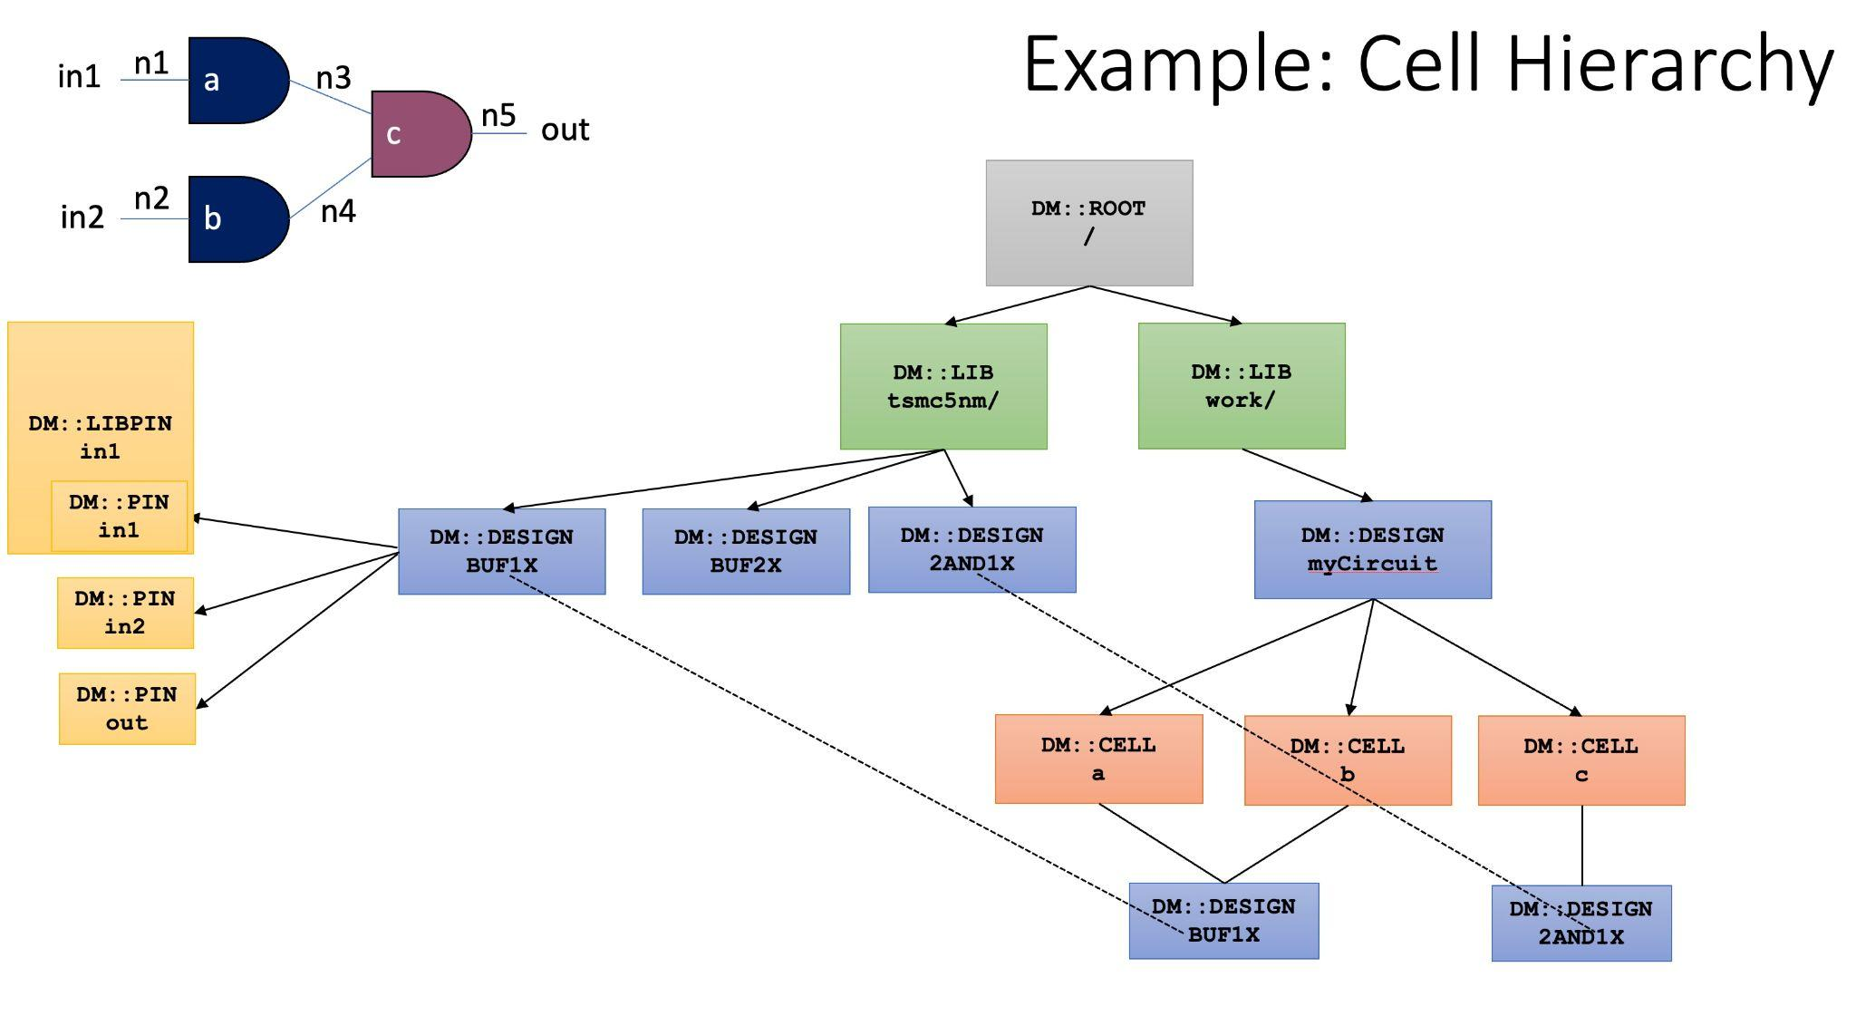
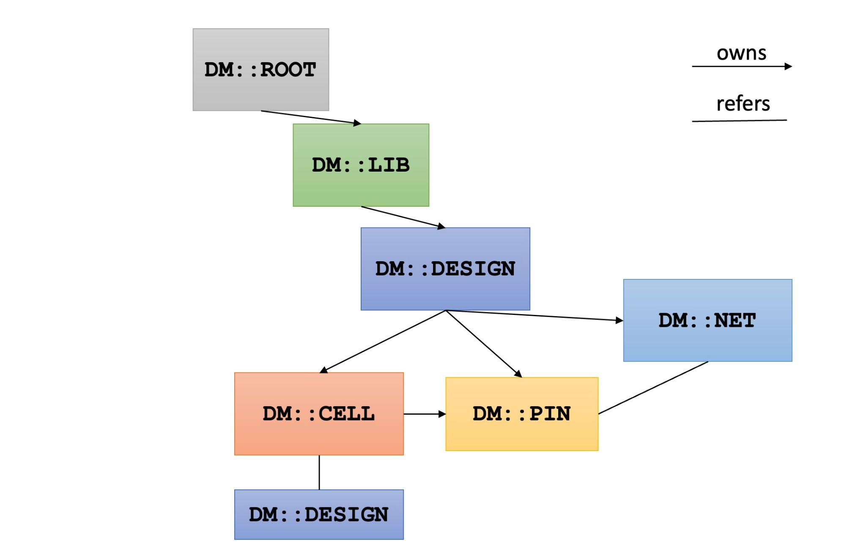
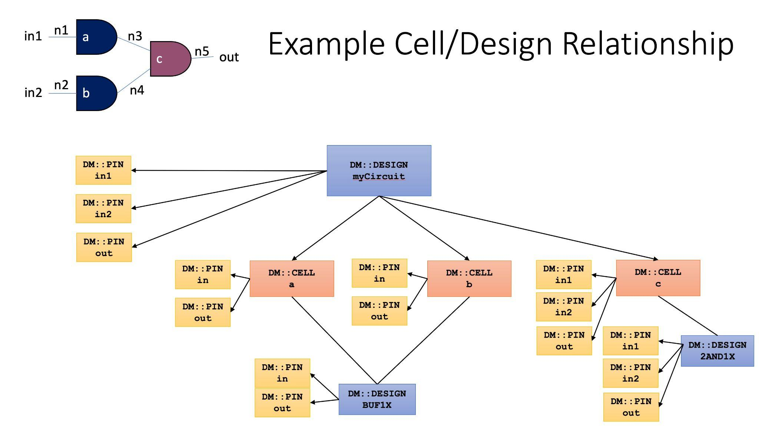
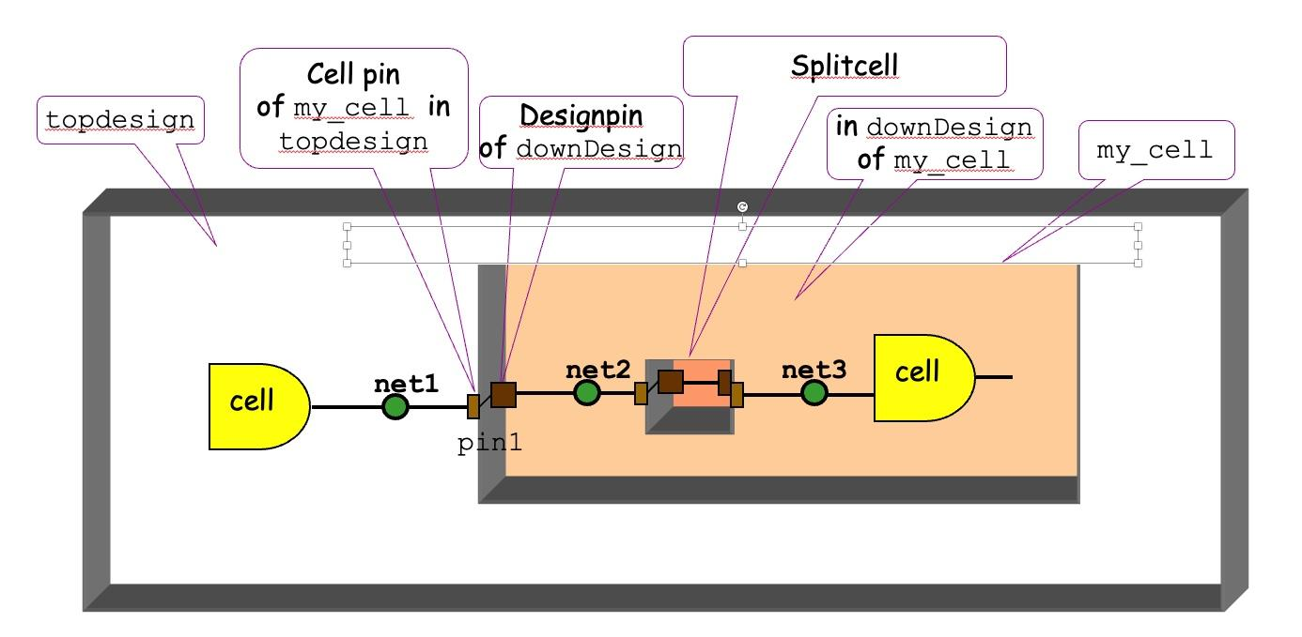
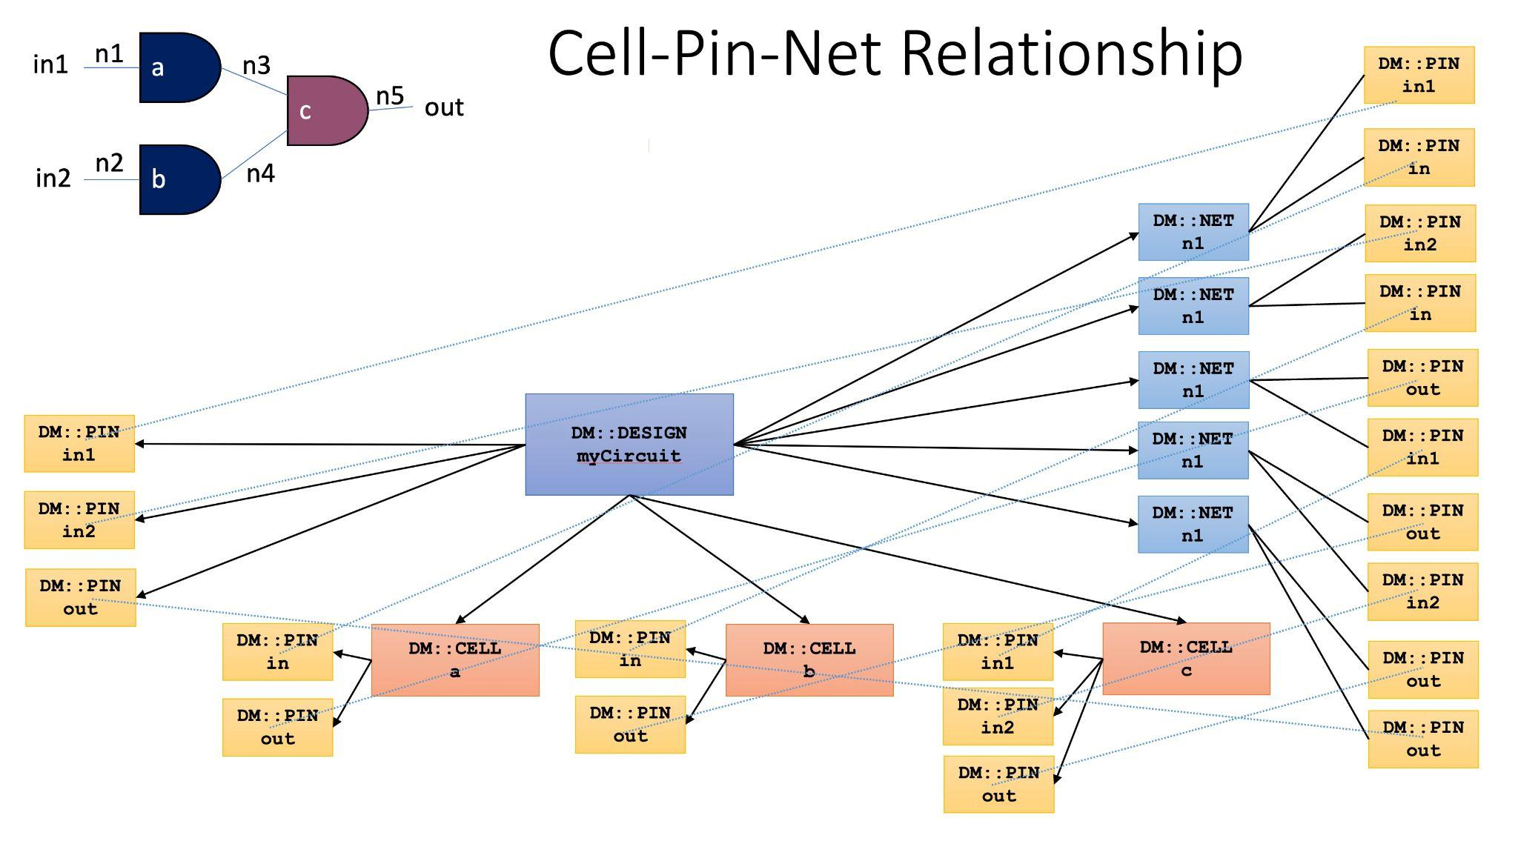
Core Data Model

Slide 11
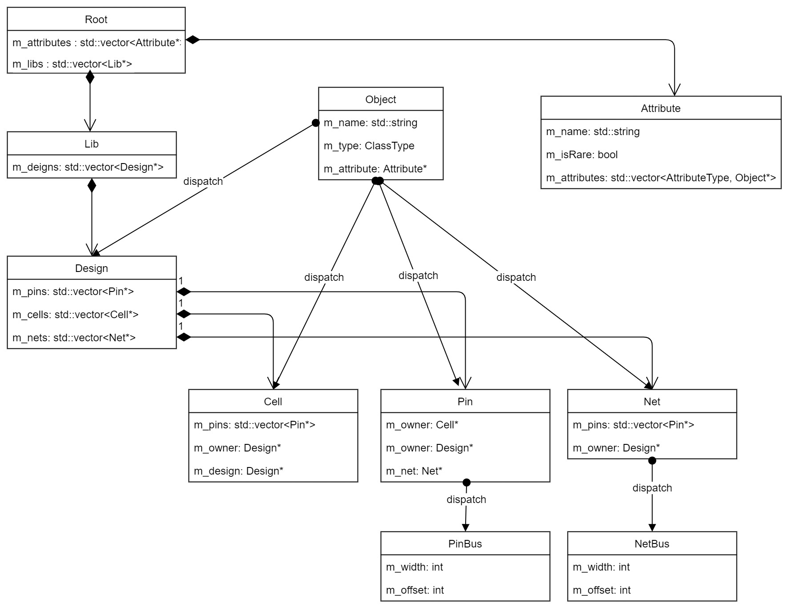
Core Data Model
struct RTLIL::IdString
struct RTLIL::Const
struct RTLIL::AttrObject
struct RTLIL::Selection
struct RTLIL::Monitor
struct RTLIL::Design
struct RTLIL::Module
struct RTLIL::Wire
struct RTLIL::Memory
struct RTLIL::Cell
struct RTLIL::SigChunk
struct RTLIL::SigBit
struct RTLIL::SigSpec
struct RTLIL::CaseRule
struct RTLIL::SwitchRule
struct RTLIL::MemWriteAction
struct RTLIL::SyncRule
struct RTLIL::Process
struct RTLIL::Binding

Slide 12
Thanks

